Slide 1
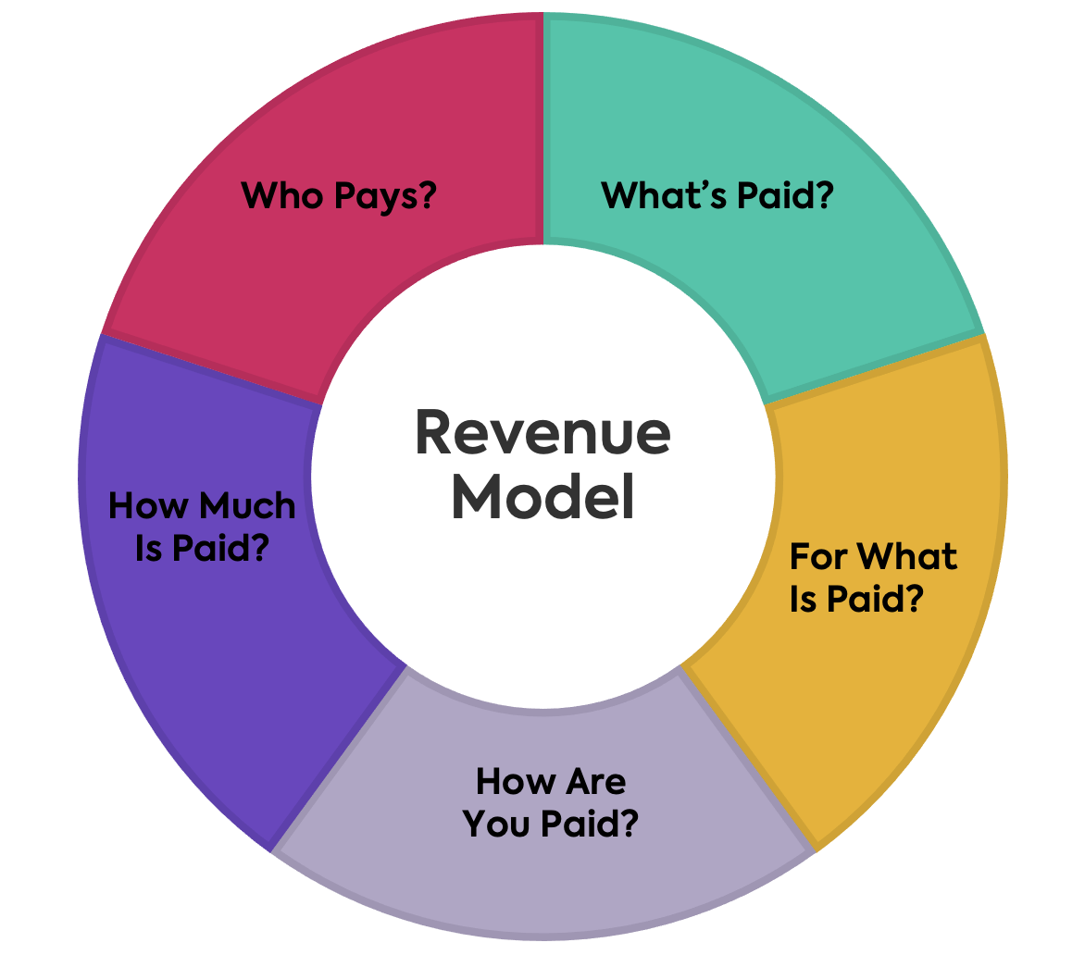
Revenue Models
Funded by the European Union
SEED+
A revenue model is a plan for earning revenue from a business or project. It explains different mechanisms of revenue generation and its sources.
The simplest example of a revenue model is a high-traffic blog that places ads to make money. Web resources that present content, e.g., news (value), to the public will make use of its traffic (audience) to place ads. The ads in turn will generate revenue that a website will use to cover its maintenance costs and staff salaries, leaving the profit.

Slide 2
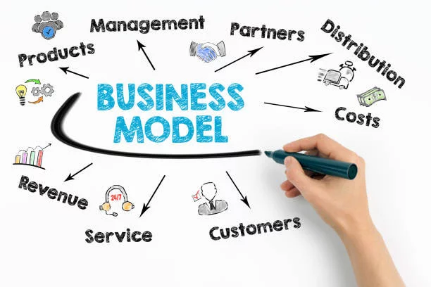
Funded by the European Union
SEED+
Revenue Model is NOT a business model
Although they might sound similar, business models and revenue models do not mean the same thing. On one hand, a business model describes indeed how an organization creates value (for both audience and itself). On the other hand, a revenue model describes instead how the money flows from the customer to the firm.

Slide 3
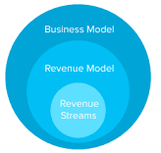
Funded by the European Union
SEED+
Revenue Model is NOT a business model

Slide 4
Revenue Model
Funded by the European Union
SEED+
Revenue Model can have several revenue streams

Slide 5
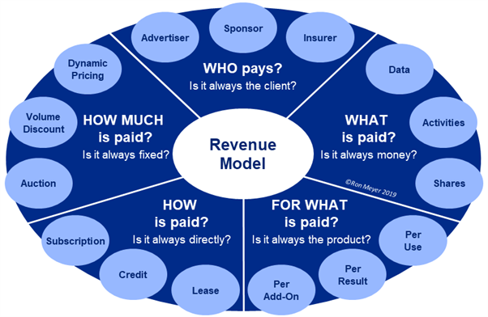
Funded by the European Union
SEED+

Slide 6
Funded by the European Union
SEED+

Slide 7
Types of revenue models
Funded by the European Union
SEED+
There are six revenue models primarily:
1- Production model
2- Renting and leasing
3- Add revenue (advertising) – as YouTube
4- Subscription model ( )
5- Freemium model (Google Drive, most of video games)
6- Markup model

Slide 8
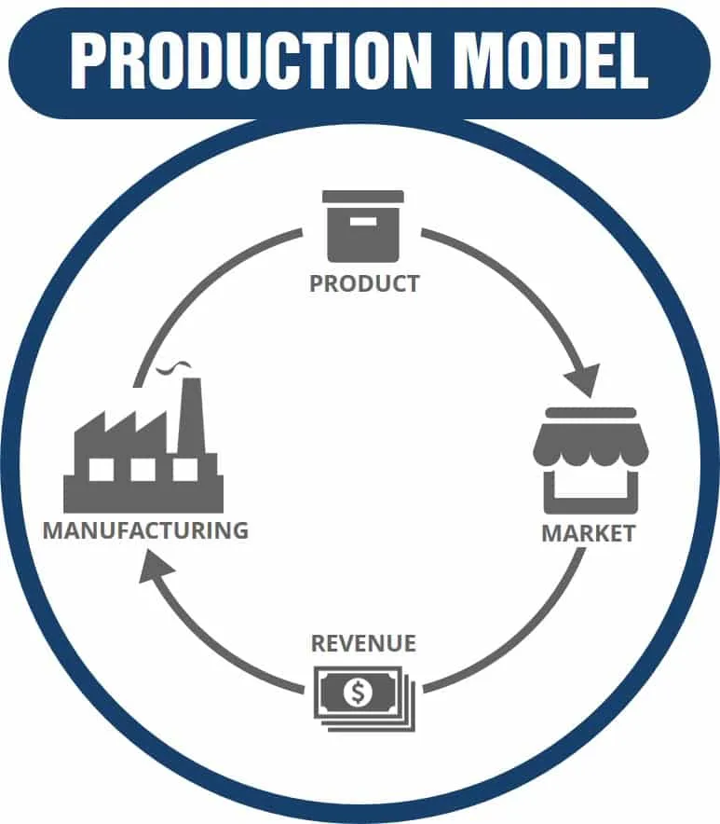
Production model
Funded by the European Union
SEED+
In the production model, the business that creates the product or service sells it to customers who value and thus pay for it.
An example would be a company that produces paper, who then sells it to either the direct public or to other businesses, thus generating revenue for the paper company.

Slide 9
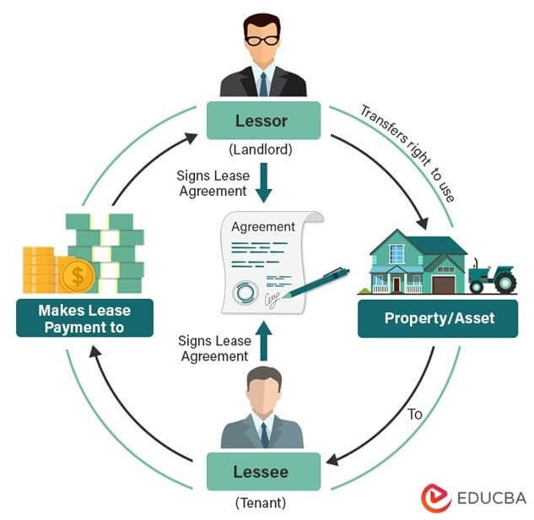
Renting and leasing
Funded by the European Union
SEED+
Under the leasing business model, a company purchases a product and then leases it to a customer for a periodic fee.

Slide 10
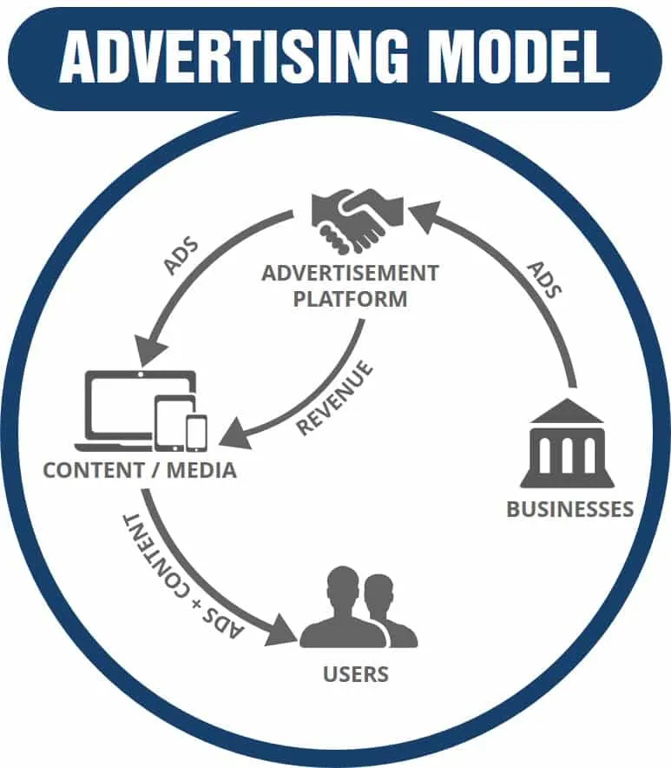
Add revenue (advertising) revenue models
Funded by the European Union
SEED+
An advertising revenue model is a business model where a company generates revenue by selling advertising space on their platform.

Slide 11
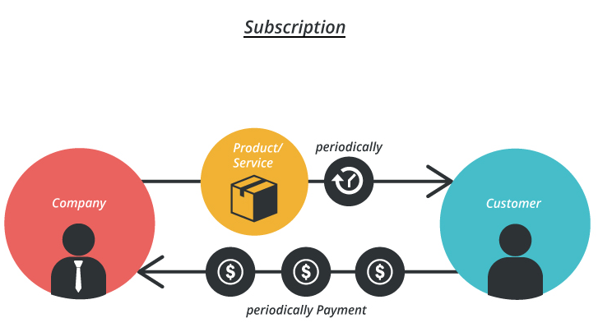
Subscription model
Funded by the European Union
SEED+
The subscription revenue model generates revenue by charging customers a recurring fee that is processed at regular intervals.

Slide 12
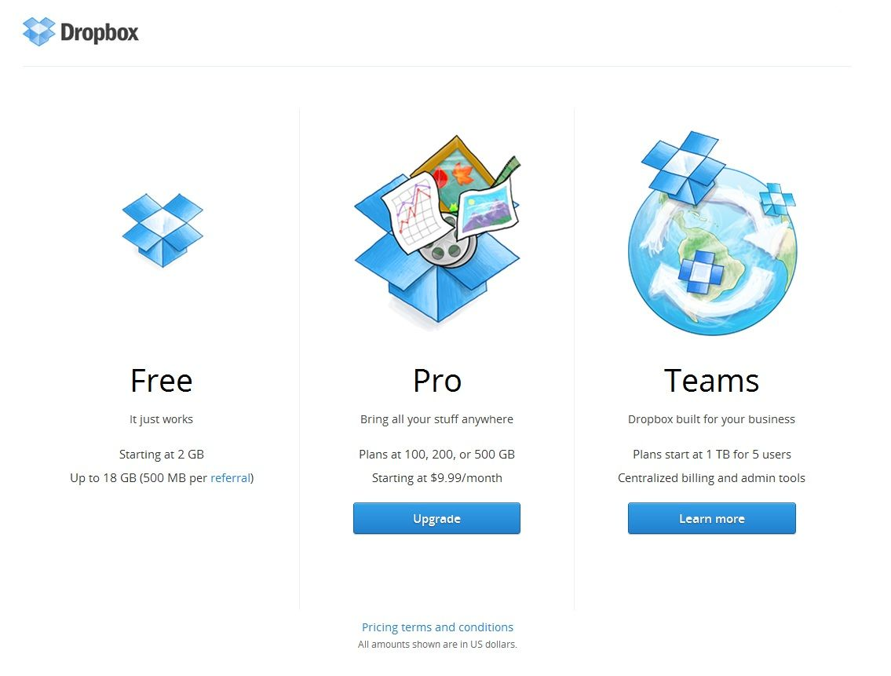
Freemium revenue models
Funded by the European Union
SEED+
Freemium is a business model in which a company offers basic or limited features to users at no cost and then charges a premium for supplemental or advanced features.

Slide 13
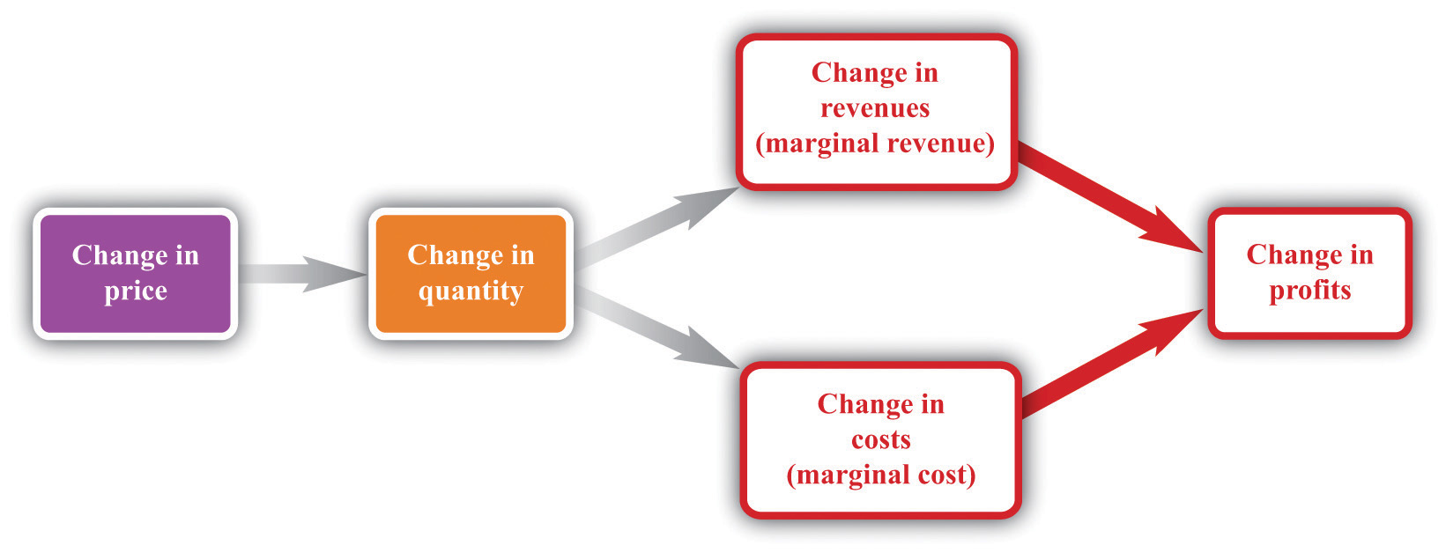
Markup revenue models
Funded by the European Union
SEED+
The markup revenue model is one of the most common revenue models across companies today. The idea is simple: buy or create a product, increase its price by X% and sell it to make a profit.

Slide 14
How to build your revenue model?
Funded by the European Union
SEED+
Example
Revenue = Average price per unit * Number of units sold

Slide 15
How to build your revenue model?
Funded by the European Union
SEED+
Example
Revenue = Average price per unit * Number of units sold
Selling swimming courses
1- Course fee
2- Donation
3- Affiliated market
4- Advertising (using your website)
5- Freemium revenue models

Slide 16
How to build your revenue model?
Funded by the European Union
SEED+
Example
Revenue = Average price per unit * Number of units sold
Selling swimming courses
1- Course fee (who pays? – Parents, Kids, Schools, Municipality)
2- Donation/sponsor (companies, municipality, NGO)
3- Affiliated market
4- Advertising (using your website)
5- Freemium revenue models

Slide 17
How to build your revenue model?
Funded by the European Union
SEED+
Example
Revenue = Average price per unit * Number of units sold
Selling swimming courses
Freemium revenue models
(Some basic courses for free)
1- Course fee (X Euro/person)
2- Donation/sponsor
3- Affiliated market
Market segment1
segment2
segment3
Revenue / Euros
4- Advertising (using your website)
Year1
Year2
Year3
Year4
Year5
Year6
Year7

