Slide 1
Venture Creation Course
Project: SEEDPlus, Strengthening Entrepreneurial Ecosystem Development
Topic 6: Customer relationship
Developed by Vesela Dicheva, PhD
CloudEARTHi

Slide 2
Content
What is costumer relationship?
Customer Relationship Management
Customer Relationship Management (CRM) Systems - Functions and Classification
Strategies for managing customer relationships
Benefits of Implementing CRM Strategies
CloudEARTHi

Slide 3
What is costumer relationship?
Customer Relations (CR) refers to the methods, strategies, and processes a company employs to build and maintain relationships with customers. Every interaction with customers influences the success of companies, enhancing their competitiveness.
CloudEARTHi

Slide 4
What is costumer relationship?
Key elements of CR:
• Trust - - in the absence of trust, there is no way to carry out transactions between the customer and the merchant, especially in the long term. Therefore, trust between them is of crucial importance.
• Respect - it is a prerequisite for good relationships. Mutual respect means partnership between the parties in negotiations and agreements. It is an attitude towards the other party and is based on tact, politeness, and courtesy.
• Value - another important element is the value of the product and the way the customer perceives it. Does the customer perceive the product in the way the company expects? Is it as valuable to him as the company claims? Successfully positioning the product high in the eyes of the customer is a guarantee of success.
CloudEARTHi

Slide 5
What is costumer relationship?
Key elements of CR:
• Open communication - Conversations with the customer, continuous clarification of their needs and desires are a guarantee of successful sales. Communicating with the customer helps determine whether the competitive advantages of the product, which the company assumes, are perceived as such in their eyes.
• Constructive conflicts - According to management theory, a constructive conflict is a confrontation that strengthens and enhances results at work, while the absence of constructive conflicts means stagnation and standing still [4].
• Responsibility - It is an important factor for good customer relationships and means that both the customer and the company-seller stand by their words.
CloudEARTHi

Slide 6
Customer Relationship Management
The term "Customer Relationship Management" (CRM) represents a comprehensive concept and business strategy for developing and maintaining customer relationships. It is based on integrating communication channels, data processing, and coordinating the efforts of all departments within the company that are involved with customers in one way or another.
CloudEARTHi

Slide 7
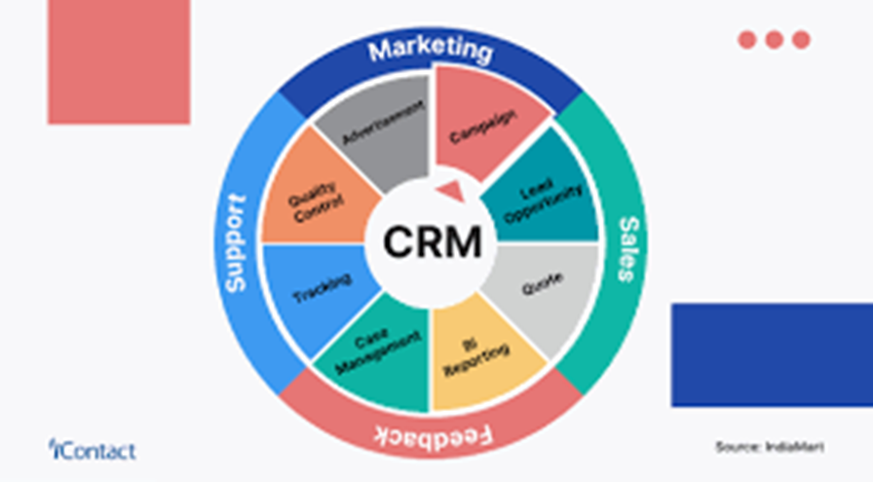
CRM concept
CRM tasks:
Identification of customers - storing and processing individual customer information. This includes identifying the customer and instant access to their profile when contact is made.
Differentiation of customers - here the principle of the Italian economist Pareto can be applied, which states: "20% of customers account for 80% of sales
Interaction with customers - here it is necessary to have information on the history of relationships with customers to track customer preferences and attempts to satisfy them through various methods of communication: websites, email, phone calls, SMS, mail.
Personalization of customers - each customer is rated by the company.
CloudEARTHi

Slide 8
Customer Relationship Management (CRM) Systems - Functions and Classification
Customer Relationship Management (CRM) system represents a set of applications through which information about customers is gathered. This information is processed, stored, and exported, providing in a format convenient for making management decisions. The main functions of the CRM system are:
• Information gathering: This information is collected in a unified database of the company, with data inputted by either an employee of the company or the customer themselves.
• Processing and storing information: This is done through technologies and corresponding applications implemented by the company, which analyze the inputted data to further export the information to various levels and departments of the company.
• Exporting information: This is an important function that allows the use of information in different departments of the company, where employees can see what products or services can be offered to the customer based on past purchases. For regular customers, the system reminds that various discounts are available.
CloudEARTHi

Slide 9
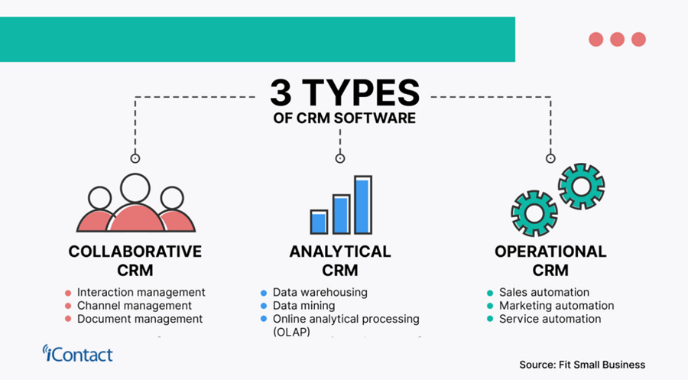
Customer Relationship Management (CRM) Systems - Functions and Classification
CloudEARTHi

Slide 10
Strategies for managing customer relationships
• Analytical Strategy: This strategy utilizes a system of programs that analyze customer data and preferences, enabling more effective business decisions by company management.
• Process Redesign Strategy: This involves analyzing processes within and outside the company, and if necessary, redesigning business processes such as sales, delivery, and customer service. The focus here is on leveraging the advantages of new technologies such as the internet, wireless communications, and other innovations to improve competitiveness, productivity, and company revenue, while also enhancing the quality of customer service.
• Marketing Strategy: This CRM strategy is primarily aimed at attracting new customers and retaining existing ones using marketing methods through various channels such as TV media, websites, email, phone, SMS, and mail.
• Customer Service: This CRM strategy is one of the key factors in maintaining existing customers and attracting new ones. The most important aspect here is to maximize customer satisfaction by establishing "customer service points" where customers can return unsatisfactory goods, provide feedback, and make recommendations for specific products to enhance their quality.
CloudEARTHi

Slide 11
Benefits of Implementing CRM Strategies:
• Increased Revenue and Profits: Finding the right CRM software that aligns with the company's business strategies and goals enables management to develop CRM strategies that increase sales and profits in the long term. This is made possible by CRM software that provides access to customer databases for their purchases and preferences, significantly facilitating employees to select and implement the right CRM strategy.
• Conversion of Potential Customers into Real Ones: This is achieved through CRM strategies that target a large number of potential customers by offering them favorable deals through various communication channels (internet, phone, mail). The goal is for these potential customers to be convinced of the quality of the company's products and services, thereby increasing future sales and profits for the company.
• Improved Customer Service: This is achieved through the use of various CRM strategies, such as customer service and feedback from customers. Customer service is often provided at designated points where users can make complaints and recommendations for certain products or services, while customer feedback is most often obtained via the internet (email), phone, or mail, where company employees ask/send questions to customers about their satisfaction with purchased products or services. This way, maximum customer satisfaction is achieved, and the quality of the products and services offered by the company is improved.
CloudEARTHi

Slide 12
Thank you for your attention
For more information please visit
https://mooc.cloudearthi.com/courses/
For questions:
vdicheva@tu-varna.bg
CloudEARTHi

Slide 13
CloudEARTHi

