Slide 1
Venture Creation Course
Project: SEEDPlus, Strengthening Entrepreneurial Ecosystem Development
Topic 5: Distribution channels
Developed by Mihail Ivanov, PhD
CloudEARTHi

Slide 2
The lecture examines fundamental questions related to the essence and types of distribution channels. Marketing intermediaries involved in building distribution channels are introduced. The main functions of marketing intermediaries in the commercial realization of products and services are discussed. Supporting links are also emphasized as important elements of every distribution channel.
Nature and Types of Distribution Channels
Distribution channels consist of functionally linked individuals and organizations tasked with moving the product from the manufacturer to the consumers. To realize the product, it must be delivered to a precisely defined location, at the most suitable time and quantity for the consumer.
Different types of distribution channels can be formed depending on the nature of the distributed goods or services (channels for consumer goods and channels for industrial goods).
Various structures of distribution channels are possible depending on the participation of market (marketing) intermediaries.
CloudEARTHi

Slide 3
Marketing intermediaries are physical and legal entities that connect the manufacturer of the goods with their consumers. They facilitate exchange and are interested in stimulating it. However, it is possible for the distribution channel to function without them. If they are absent, their functions are taken over by the manufacturer, who directly contacts the consumers. This is feasible and profitable only for a limited number of investment goods - airplanes, ships, internal combustion engines, and turbines for power plants, which are complex and expensive, made only to order based on pre-existing contracts between the manufacturer and the consumer. The prerequisite for using this option is the small number of consumers, the need to discuss the technical parameters of the products, and the provision of repair and maintenance during operation.
CloudEARTHi

Slide 4
Marketing intermediaries involved in building distribution channels are divided according to the nature of their activities into:
Merchants (wholesale and retail) In the process of exchange, they acquire ownership rights over the goods and have relative independence in choosing sales methods, trade markups, and market selection.
Functional intermediaries (commercial agents and brokers) They expedite exchange without acquiring ownership rights over the goods. They receive commissions for their activities. Their commissions are usually smaller than the potential profit of the merchants, but this corresponds to the lower responsibility and risk they assume. Functional intermediaries are suitable for trading standard goods in large quantities with pre-set parameters. For example, wheat with a certain moisture content and percentage of impurities, cotton, coffee, cement, oil, etc.
CloudEARTHi

Slide 5
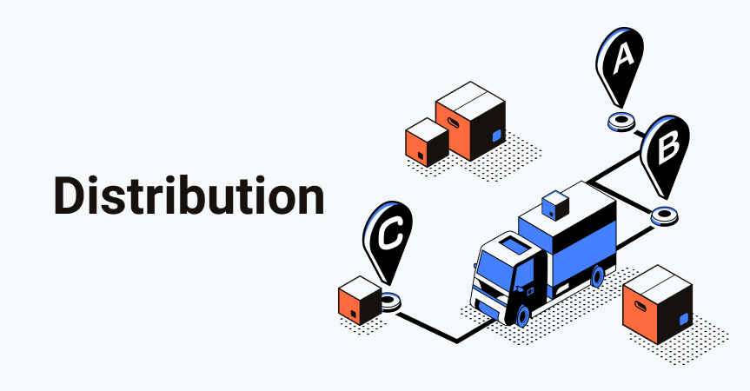
Distribution channels function as a system of interconnected links that can achieve their goals only through cooperation. This cooperation is built on contracts, voluntary and involuntary organizational measures within the framework of the law, which are difficult to synchronize. Therefore, changing the distribution channel requires more time and resources than, for example, changing packaging or advertising methods.
The main types of configurations in the distribution channels for placing consumer goods are as follows:
Channel A is called "direct." It has the simplest structure. Its peculiarities have already been discussed. It represents a temptation for manufacturers who wish to receive the income due to intermediaries without realizing that they must perform a series of activities that are not typical for producers. This is possible with small quantities of production. For example, a producer of agricultural products may attempt to sell them directly to the end consumer through cooperative retail markets, avoiding wholesale markets organized for the purchase of fruits and vegetables. However, the simplicity of the channel does not guarantee high efficiency.
CloudEARTHi

Slide 6
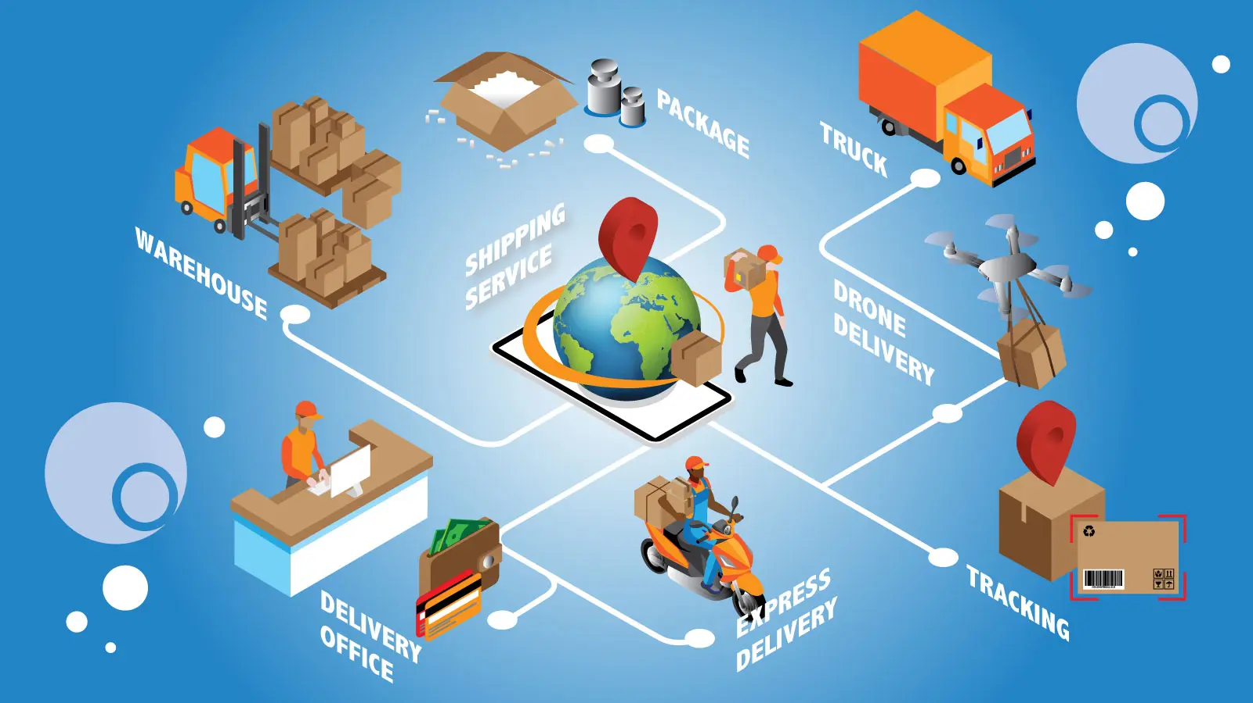
Channel B is suitable for placing industrial goods (refrigerators, televisions, cars, etc.). In this case, the retailer buys directly from the manufacturer. This is possible because such goods are sold in a limited number of retail outlets. If there are complaints or unexpected changes in consumer demand, the short channel allows for quick reactions. Such a channel structure is also suitable for goods with a limited shelf life (bread, milk).
Channel C is typical in the trade of mass consumer goods (oil, sugar, chips, croissants, etc.). These goods are sold in a large number of retail outlets, and the manufacturer would find it difficult to contact each of them directly. Retailers dealing with such goods prefer to stock small quantities to avoid tying up working capital and keeping stocks for too long, especially since warehouse space is required. It is unprofitable for them to source the goods directly from the manufacturer, who may be geographically distant (in another town).
CloudEARTHi

Slide 7
In some cases, different marketing channels can be used for the same product. For example, large end consumers of food products may be supplied directly by wholesalers and manufacturers (such as hospitals, daycare centers, military units), while individual households purchase the same products from retailers. Such mixed options are typical for products that serve both consumer and industrial purposes (such as flour).
In some cases, however, simultaneously using multiple distribution channels can lead to conflicts between wholesale and retail traders. This is the case when wholesale warehouses allow the purchase of small quantities or individual items by end consumers at wholesale prices, or when an importer, a monopoly for a certain product (such as bananas), reveals its branded retail stand, placing other retail traders at a disadvantage, those who stock from them. Retailers also face challenges competing with large retail chains that deal directly with manufacturers (such as Metro, Carrefour, Kaufland).
The number of intermediary links in a distribution channel is determined by the nature of the goods and the scale of the market. In conditions of free competition, inefficient intermediary links cannot survive. It cannot be argued that the elimination or reduction of the number of intermediaries will necessarily lead to higher efficiency, as their functions remain and must be assumed by someone else, who will combine several functions and thus achieve lower quality at higher resource costs.
CloudEARTHi

Slide 8
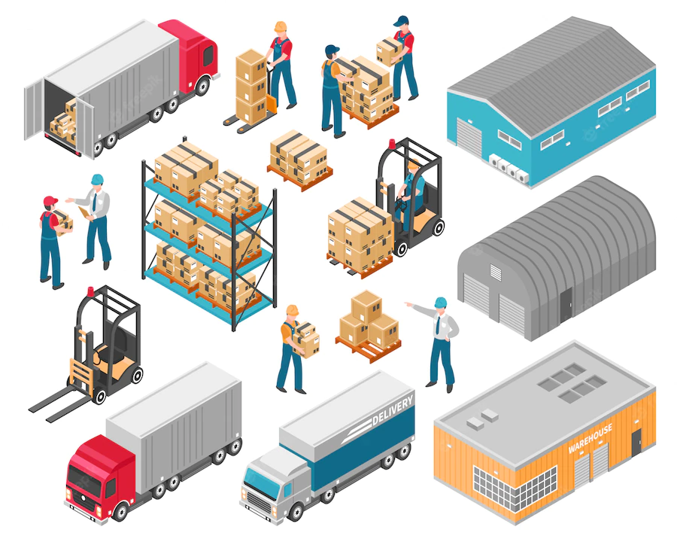
Consumers prefer shorter sales channels, assuming that the fewer intermediaries there are, the lower the prices will be. The elimination of wholesalers will not eliminate the need for the services they provide. Then, other institutions will have to perform these services, and consumers will also have to pay for them. Even if producers and buyers are in the same settlement, there are costs associated with the exchanges. If we have four producers and four buyers, 16 transactions are necessary. If one intermediary serves both producers and consumers, the number of transactions will be halved - eight.
CloudEARTHi

Slide 9
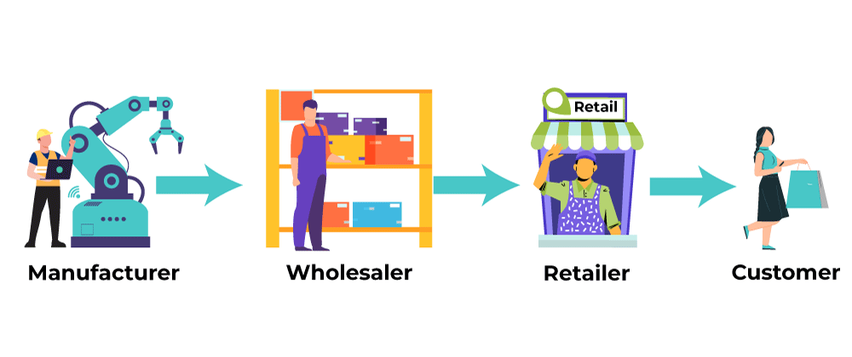
Functions of Intermediaries
Often, a specific manufacturer cannot satisfy the wide range of preferences of end consumers. The reason is that the quantity and assortment of the produced goods do not match the market's needs. In such cases, marketing intermediaries perform a series of sorting activities to overcome these discrepancies. These sorting activities boil down to: sorting, accumulation, allocation, and assorting.
Sorting involves distributing the produced goods into homogeneous groups. The characteristics based on which this distribution is carried out should be easily distinguishable (size, color, quality). Sorting activities are often encountered when dealing with agricultural products. For example, sorting by taste or vitamin content can be difficult to achieve. Sorting allows for price differentiation and the satisfaction of different needs (for example, fruits for processing and for fresh consumption). For some widely distributed goods, there are accepted standards. With them, sorting can be reduced to distinguishing those items that meet the standard from the others that deviate from it beyond allowable norms.
CloudEARTHi

Slide 10
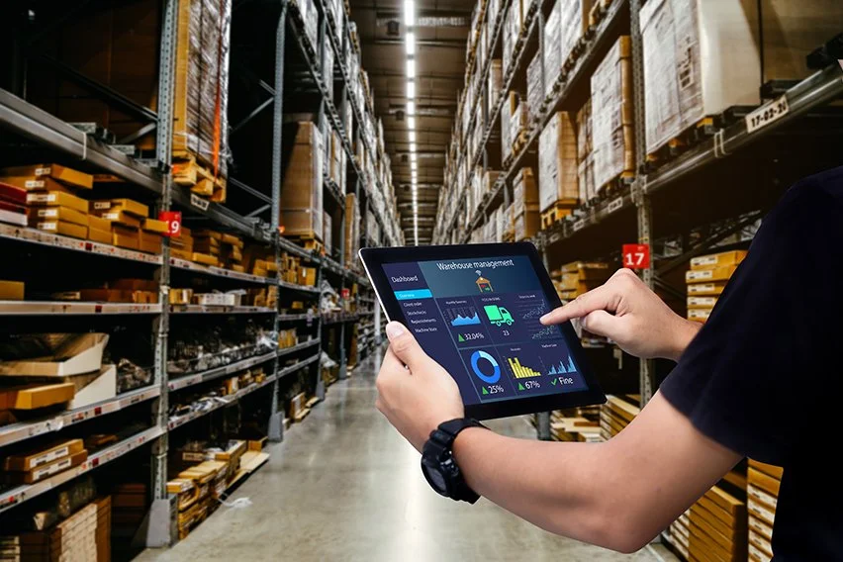
Accumulation. It involves creating a stock of homogeneous goods, through which intermediaries overcome the discrepancy between the produced and demanded quantities. In this way, transportation and processing become more efficient, supply to the market can be rhythmic, and production capacities can be fully utilized. For example, the production of new shoe collections begins long before the season for which they are intended. They are accumulated to meet increased demand during the peak of the season, which exceeds production capabilities. A specific example is storing agricultural products in specially built fruit storages.
Allocation is the division of formed large stocks into smaller units. The wholesaler has purchased and transported large quantities of goods at preferential prices, which he distributes among retailers. Profit plays a leading role - that is, the efficiency of the distribution channel's functioning.
CloudEARTHi

Slide 11
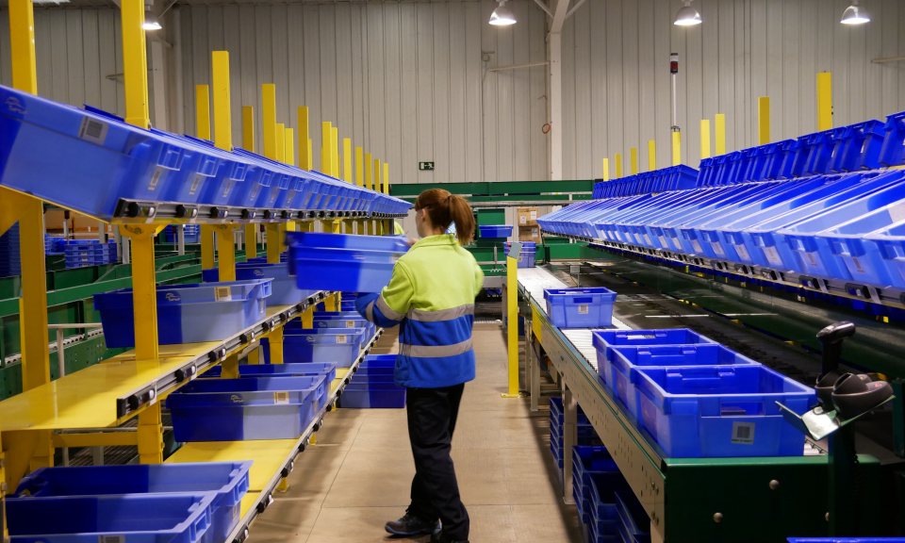
Assorting is the process of combining goods that the buyer would like to receive in one place.
For example, the dairy product stands at large grocery stores offer homogeneous products from different manufacturers with specific taste qualities, different packaging, and presentation. The variety of goods offered in one retail store must correspond to its size and the tastes of the buyers. For example, a small neighbourhood grocery store may have a relatively limited assortment because it serves regular customers whose preferences are known. A large store located in a central location must have a wide range of products to meet the requirements of the intensive flow of both regular and occasional visitors with different purchasing capabilities and consumer habits.
CloudEARTHi

Slide 12
Organization and Management of Distribution Channels
Managing distribution channels is not an easy task. Competition and the pursuit of efficiency are driving forces for creating increasingly sophisticated forms of distribution channels. There is no universal organization of a distribution channel that works equally well for all types of goods and all markets, but there are certain principles whose understanding can facilitate the choice of an appropriate channel and support its smooth operation.
The main points worthy of attention regarding the organization and management of distribution channels are:
Market coverage selection;
Utilization of opportunities for vertical and horizontal integration in the channel;
Collaboration among channel participants.
CloudEARTHi

Slide 13
Market coverage in practice means the number and type of sales points available to the channel. The three characteristic levels of market coverage are: intensive, selective, and exclusive distribution.
Intensive distribution is typical for "convenience" goods, which are purchased frequently, and for consumers, it is most important for them to be nearby and available at all times. These are basic groceries, cigarettes, and alcohol. They are offered in a large number of retail outlets, and the main condition for successful sales is availability.
Selective distribution is used for goods that are purchased less frequently and have a higher price. Consumers are willing to spend more time comparing and researching them. For these products, instructions for use and warranty cards are provided, and the personnel selling them must have special knowledge about safety techniques and the specific advantages of the product. Examples include household appliances, furniture, and computers.
Exclusive distribution is a method of offering products through a specialized outlet covering a relatively large territorial area. It can be applied to complex and rarely sought-after items – for example, agricultural machinery, medical equipment, etc. The choice of market coverage largely determines the structure of the distribution channel.
CloudEARTHi

Slide 14
Channel integration is driven by the desire to synchronize the work of individual links in it to eliminate unnecessary costs and ensure unity of interests.
The main forms of vertical channel integration are: corporate, administrative, and contractual. Corporate integration is based on unified ownership. For example, the manufacturer owns the stores where its products are sold. Administrative integration is based on an informal agreement between channel participants for a unified strategy and cooperation. In the contractual form, the relationships between channel participants are regulated by signing an agreement.
Horizontal integration among equal participants in the channel is also possible, for example, the consolidation of retailers or wholesalers into industry organizations. This allows them to jointly bear some marketing costs, provide mutual assistance in accounting – optimizing inventory volume, or jointly using transportation and warehouse facilities.
CloudEARTHi

Slide 15
Cooperation among participants in the distribution channel is no longer just an ethical principle but also a survival strategy and a condition for prosperity. Cooperation and goodwill can be established if each participant in the channel knows what is expected of them and strives to be fair. For example, the wholesaler expects the manufacturer to maintain effective quality control, periodically update the product, and inform them about upcoming changes. The retailer expects the wholesaler to provide regularity in deliveries and a suitable assortment. The wholesaler expects the retailer to regularly pay for deliveries and to be loyal to them by not stocking similar goods from other wholesalers. The pursuit of maximizing profits sometimes leads to violations that create conflicts. For example, retailers try to bypass wholesalers by connecting directly with manufacturers, or manufacturers engage in direct sales, thus eliminating intermediary traders. Competition between retailers selling the same product in a market with a limited territorial scope is possible. The potential for such misunderstandings constantly exists, and various measures are taken to reduce it. For example, a manufacturer may direct different products to individual retailers in a specific area to prevent conflicts between them. A secure way to eliminate the threat of conflicts among channel distribution participants is by establishing leadership within it. The leader dominates and sets the rules of operation, requiring not only willingness but also the ability to enforce their will on other channel participants. The methods of influencing other channel participants to adhere to established cooperation rules (such as trade discounts, sales areas, product assortment, etc.) can be conditionally divided into economic and non-economic.
CloudEARTHi

Slide 16
Economic methods of influence predominate since in a democratic and legal society, economic entities are free to determine their own priorities and strategies for their realization. Economic influence is exercised through control over resources, dominant market position, price setting, incentivizing through larger trade discounts, and credits for loyal channel participants. Among the non-economic methods of influence, expertise is noteworthy, based on special qualifications or technology necessary for the successful operation of the channel, and the power of authority wielded by industry organizations.
Leadership in the channel can be assumed by either the manufacturer, wholesaler, or retailer. Typically, the fight for leadership involves a combination of methods (new technologies, consulting services, pricing tactics, providing credits, discounts, and privileges). The chances for different participants in the distribution channel to become leaders are largely determined by their economic power and adaptability.
CloudEARTHi

Slide 17
Supporting Links
Supporting links are usually not part of a specific distribution channel. They exist because they provide services that support the functioning of distribution channels, and in principle, their activities can be undertaken by some of the channel members. Such supporting links include transportation companies, insurance companies, advertising agencies, marketing research firms, public warehouses, and storage facilities. A distinguishing feature of supporting links regarding direct channel participants is that they do not participate in transactions; they merely expedite and facilitate their execution without acquiring ownership rights over the goods or participating in decision-making regarding channel management.
CloudEARTHi

Slide 18
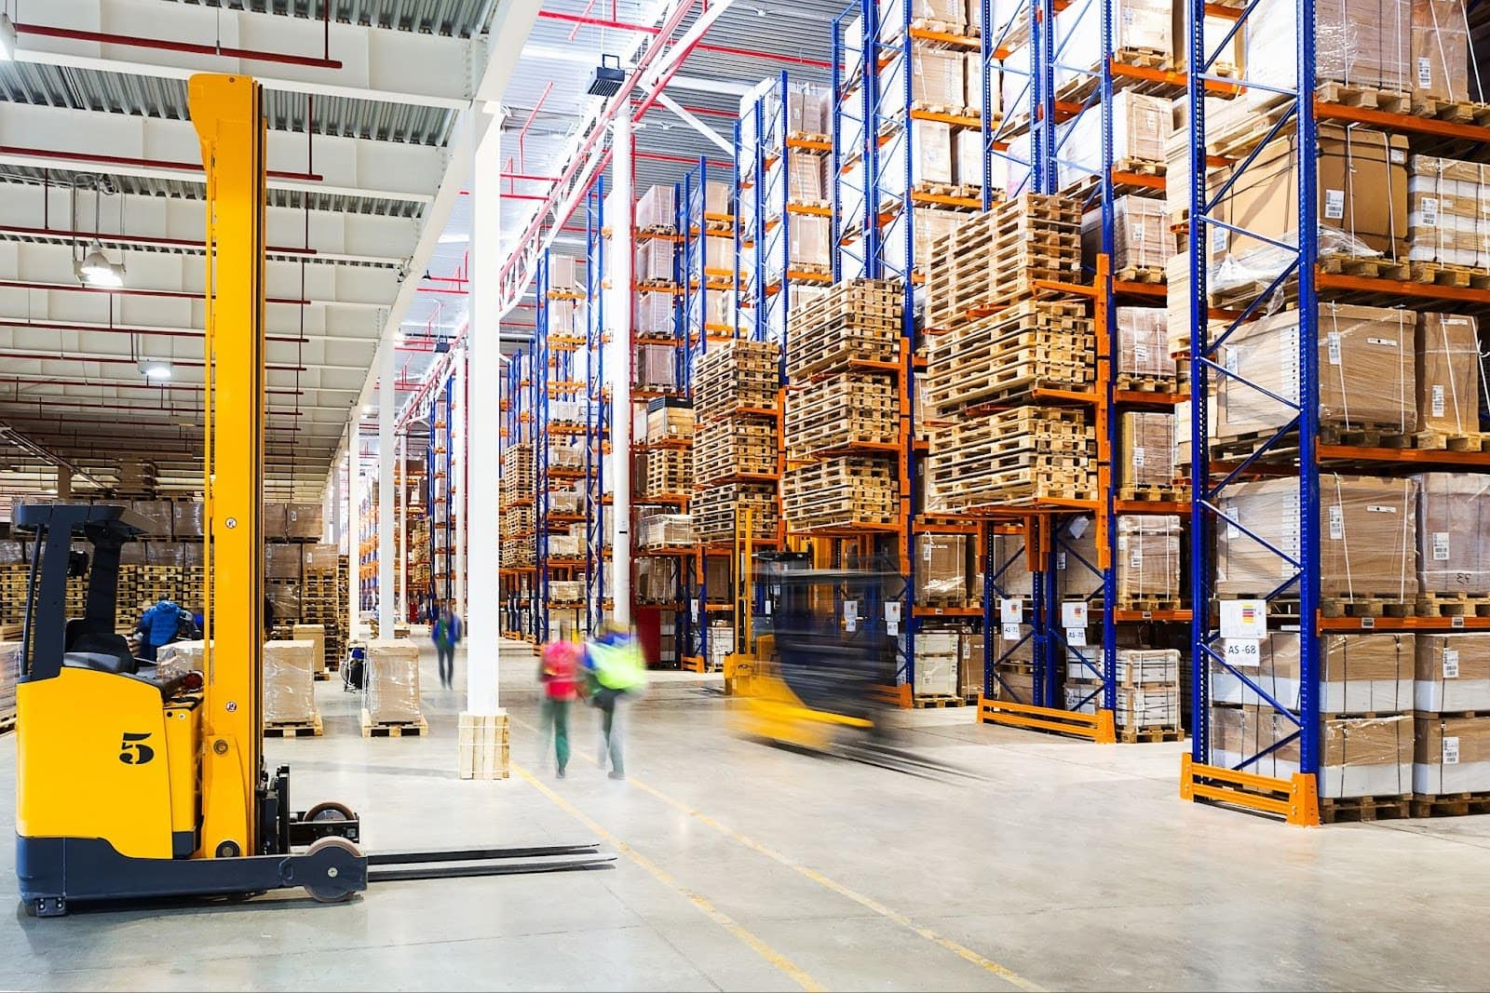
Public warehouses and storage facilities serve for the temporary storage of goods, processing, sorting, and packaging. They can be used for a fee for a specified period, eliminating the need for distribution channel participants (primarily manufacturers and wholesalers) to build their warehouses throughout the territory where they conduct placement activities. Such warehouses are usually used for transit goods or for deliveries over long distances where it is not profitable to transport small quantities rhythmically. In Bulgaria, such warehouse areas (open and closed) are offered by free trade zones operating in the cities of Burgas, Plovdiv, Ruse, Vidin, Dragoman, and Svilengrad. Public refrigerators are mainly used for agricultural products that need to be prepared for export (raspberries, strawberries) or stored in good commercial condition for sale during the winter months (apples, grapes). In addition to storage and processing facilities, public warehouses and refrigerators provide security for goods and, in some cases, facilities for conducting transactions (rented offices, telephone, fax, customs services, exhibition halls, and tasting rooms).
CloudEARTHi

Slide 19
Transport companies are organizations that own their transport vehicles or use rented ones to provide specialized transport of goods without distance restrictions. They take care of insuring the vehicles and goods, organize loading and unloading activities, develop delivery schedules, and recommend the most suitable type of transport for each specific case. For bulk goods, maritime and river transport is the cheapest, followed by rail transport. Many European governments are implementing measures to stimulate the use of rail transport for freight. The reason is that it does not cause environmental pollution. Road transport has experienced the fastest development in recent years due to the ability to deliver goods quickly and without overloading them to the most remote settlements.
Advertising agencies offer specialized assistance in the development and dissemination of advertising materials (printed materials, videos, and souvenirs). They are useful to distribution channel participants with their experience and established network for distributing advertising materials. In an already established distribution channel, they contribute to increasing its efficiency and success in the fight against competitors.
CloudEARTHi

Slide 20
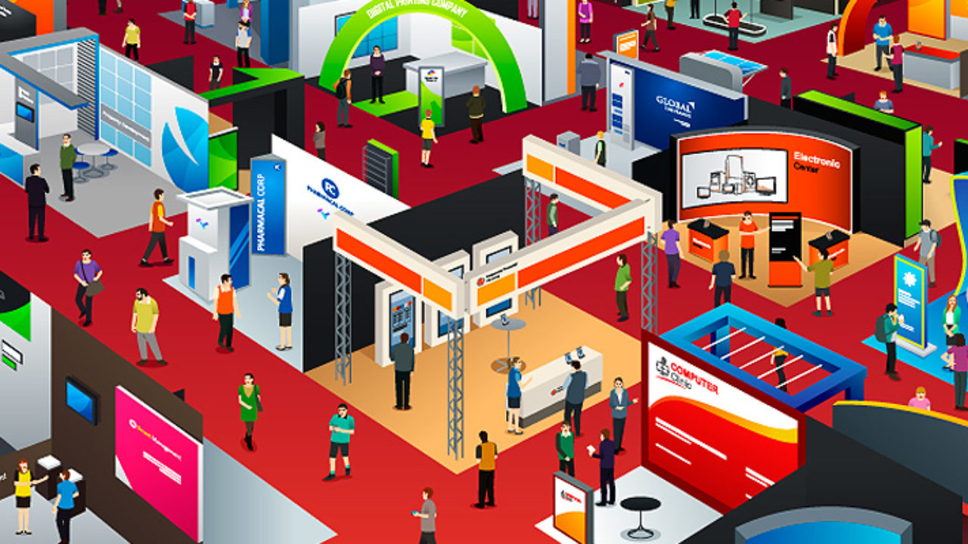
Trade exhibitions are usually held periodically in one place with the aim of establishing contacts between manufacturers, traders, and end customers. The gathering of many related products at one exhibition allows them to be compared, and traders can choose exactly what is needed for the market they operate in, while manufacturers can understand the level of their competitors. Sometimes, for advertising purposes, exhibits are sold directly to consumers, which, on the one hand, prepares the market for new products but, on the other hand, makes it difficult for manufacturers to provide service because individual units are involved. Participation in trade exhibitions, besides economic benefits, is also a source of prestige.
CloudEARTHi

Slide 21
Thank you for your attention!
For more information please visit
https://mooc.cloudearthi.com/courses/
For questions:
mihail.ivanov@tu-varna.bg
CloudEARTHi

Slide 22
CloudEARTHi

