Slide 1
SEEDplus Venture Creation Programme
Funded by the European Union
SEED+ Venture Creation Course
Term 2: The Lean LaunchPad

Slide 2
Course Introduction
Building on ‘Venture Creation course: ‘Foundations’ and the SEEDplus project
Course overview
Who is it for?
Why take the course?
How is it different from the Foundations course?
What’s ahead after the course?

Slide 3
Introducing the Lean LaunchPad Methodology
How to build a startup
What is a startup (and what is it not)
Customer-centric
Direct interaction with customers
The Business Model Canvas
Fail fast, learn quick
MVP
"No business plan survives first contact with customers."
Steve Blank

Slide 4
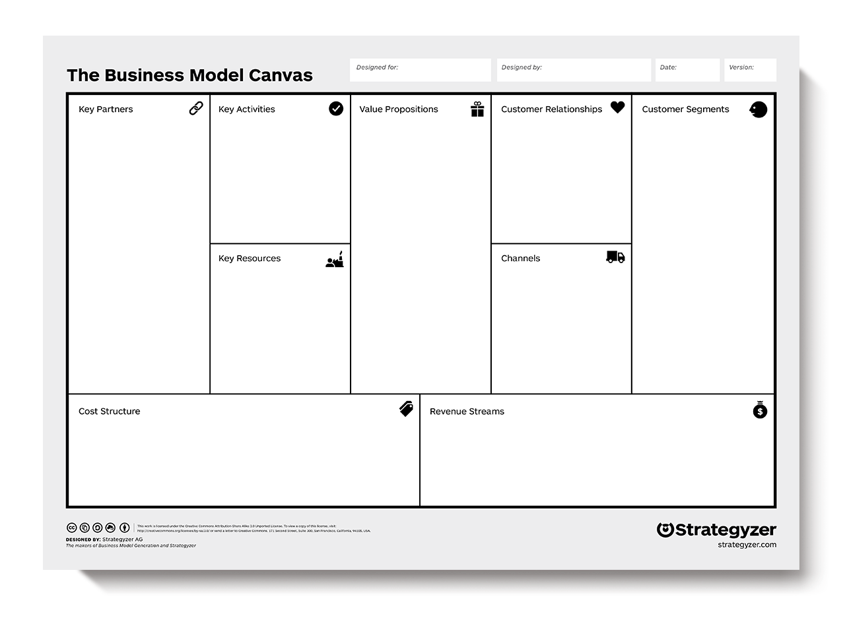
The Curriculum
10 week course
Introduction to the course
Business models and customer development
Value propositions
Customer, users, and payers
Distribution channels
Customer relationships
Revenue models
Partners
Key resources and costs
Playback and lessons learned

Slide 5
Course Activities
Course delivery:
Self-led startup tasks, participants-led interactive seminars with facilitated breakout sessions
Available materials:
topic overview videos, additional reading, weekly activity brief
Materials stored at SEEDplus programme page and on the KAU Canvas platform
Additional services: Grill the Leader workshops
Expectations on participants:
1.5hrs seminar and grill the leader
2-4hrs outside classroom time
Upload of weekly progress update to relevant university portal and presentation in seminar
Startup ideation and team building support:
https://community.cloudearthi.com/forums/Forum/seedplus-innovation-competition/

Slide 6
Course Logistics
Logistics: Virtual delivery across all partners
Seminar: Wednesday @ 17:00 CET
Grill the Leader: Thursday @ 17:00 CET
N.b. exception next week, Grill the Leader to be Monday 19 February @ 16:00 CET
Term dates:
Stage 1: w/c 12 February - w/c 18 March
Mid-term break: w/c 25 March - w/c 01 April
Stage 2: w/c 08 April - w/c 29 April
23rd, 24th, and 25th April - BOOST Camp event
Language: All sessions and submissions to be delivered in English
Course recognition
University specific recognition through credits or certificates

Slide 7
Post-Course Activities
Pitching support
Early May
Local competition
Mid May
International pitch opportunity - CloudEARTHi conference
End June
International competition
September - October
Startup Acceleration services from G-Force and FastTrack
Q4 2024 / Q1 2025

Slide 8
The Delivery Team and SEEDplus team
Fast Track Ventures
Portugal
The information presented in this presentation is solely the opinion of the project and does not necessarily represent the views of the European Union, other funding agencies, or partner institutions.

